Slide 1
Agenda
Elastic Agent Overview
Decision Tree for Ingestion to Elastic
Deployment Options for Elastic Agents
Demo

Slide 2
Overview
Elastic Agent is a single, unified way to add monitoring for logs and metrics to a host.
The integrations (over 400+) that come with Elastic Agent provide an easy way to connect external services and systems to Elastic.
These integrations simplify the process of collecting, parsing, and shipping data from various sources, such as cloud services, security tools, observability stacks, and more.

Slide 3
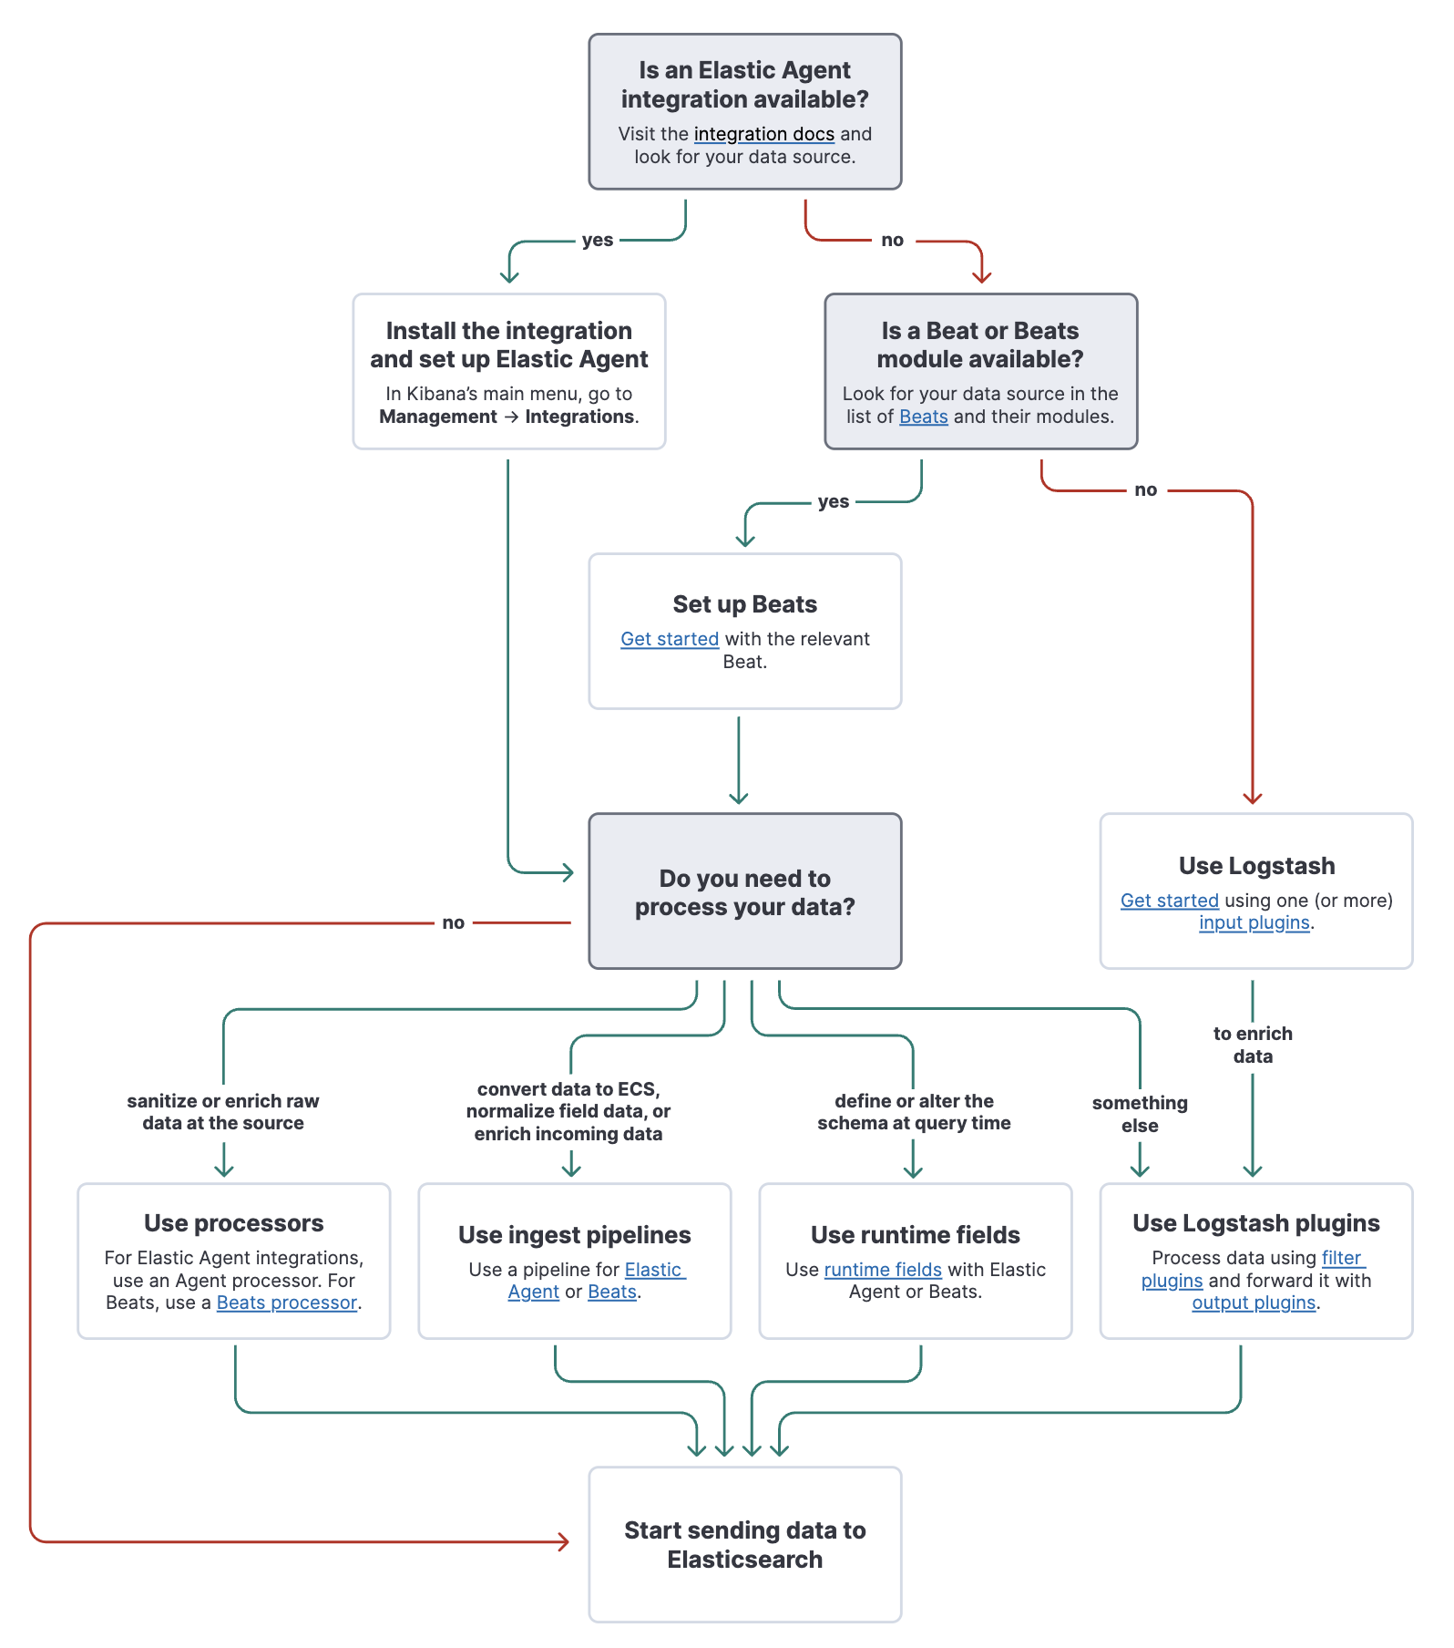
Ingestion Decision Tree

Slide 4
Elastic Agent Deployment Options
Fleet-Managed Elastic Agent
Fleet
A centralised management where you can see the state of all Elastic Agents
Serves as the communication channel back to the Elastic Agent
It follows a server-client model, where Fleet acts as the central server and Elastic Agents function as distributed clients.
Must be deployed on a supported infrastructure, such as Windows, Linux, macOS, Kubernetes, or Docker
Makes the management and upgrade of Elastic Agents easier
Fleet-Managed Agentless (Beta)
Ingest data without deploying an Elastic Agent.
Currently limited to certain integrations (e.g. AWS, Okta, CrowdStrike, etc.) and is in beta.

Slide 5
Elastic Agent Deployment Options (cont.)
Standalone Elastic Agent
Useful when central management via Fleet is not required:
either due to specific security requirements
or a preference for an alternative configuration management system
Elastic Agent has to be installed and manually configured on each host that needs to be monitored
User is responsible for managing and upgrading each Elastic Agents
Elastic recommends Fleet-Managed Elastic Agents, when possible, because it makes the management and upgrade of agents considerably easier

